Slide 1
Learning the Structure of Biomedical Relationships from Unstructured Text
Bethany Percha, Russ B. Altman
160822

Slide 2
Preprocessing (drug-gene relationship extraction task):
1. Identify all drug-gene pairs co-occurring in sentences within a corpus of text.
2. Extract all dependency paths connecting these drug-gene pairs in the corpus
3. Arrange the data in an n x m matrix where the rows represent drug-gene pairs and the columns dependency paths.
EBC algorithm:
4. (Unsupervised step.) Use Information-Theoretic Co-Clustering to bicluster the n x m matrix N times, recording the number of runs in which each row appears in a row cluster with each other row.
5. (Supervised step.) Identify a seed set, S, of rows that share some property of interest.
Rank the entity pairs in a test set, based on a scoring function related to how often they co-cluster with members of seed set.

Slide 3
Quantifying the variability of drug-gene descriptions in Medline sentences
The full set of abstracts from the 2013 edition of Medline contains approximately 184,000 sentences in which at least one drug name and at least one gene name are present.
Many of these sentences contain multiple drug and gene names; the total number of unique drug-gene-sentence combinations is approximately 236,000.
As described in the Methods, we use dependency parsing to prune away irrelevant terms and phrases and focus attention on the parts of a drug-gene sentence most relevant to the relationship between a drug and a gene.
The pruned versions of drug-gene sentences are called dependency paths.
For Details about the meanings of the individual grammatical dependencies

Slide 5
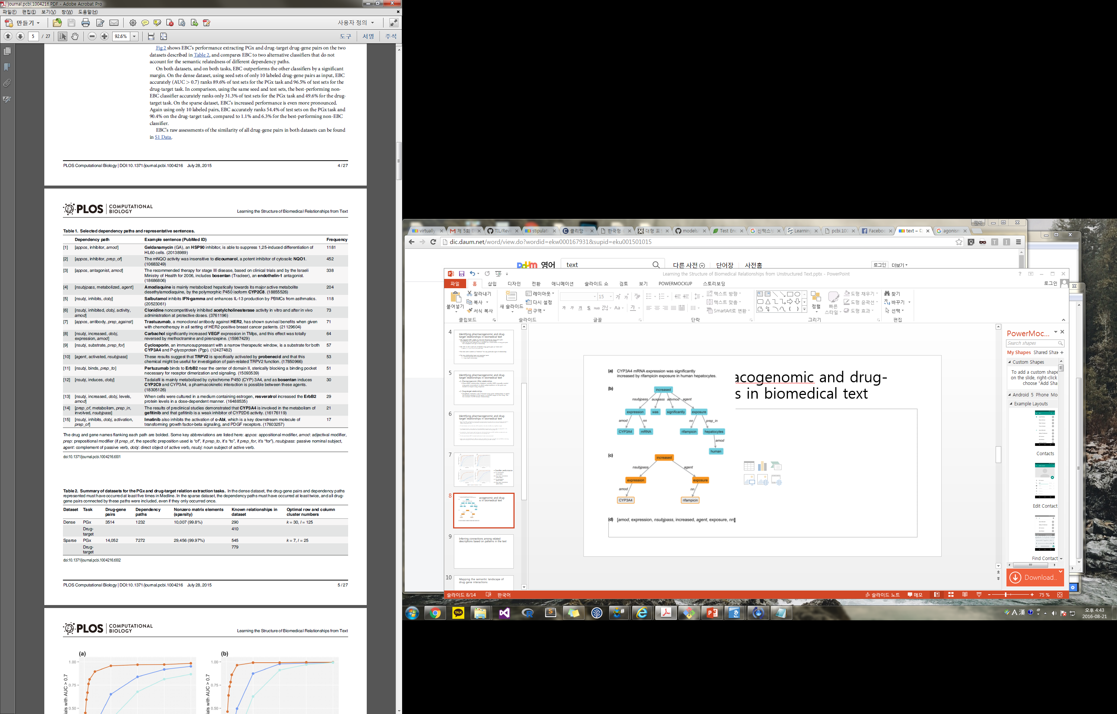

Slide 6
Identifying pharmacogenomic and drug-target relationships in biomedical text
We evaluated EBC’s ability to mine the literature for drug-gene pairs exemplifying two specific types of drug-gene relationships.
With only the full, unlabeled text of Medline and a small number of drug-gene pairs that exemplified each type of relationship.
We refer to the small sets of labeled drug-gene pairs as “seed sets”.
(sizes 1, 2, 3, 4, 5, 10, 25, 50, and 100)
No texts were marked as “evidence” for any particular type of relationship.
The two relationship types we examined were:
1. Pharmacogenomic (PGx) relationships.
2. Drug-target relationships.

Slide 8
Identifying pharmacogenomic and drug-target relationships in biomedical text
Fig 2 shows EBC’s performance extracting PGx and drug-target drug-gene pairs on the two datasets, and compares EBC to two alternative classifiers that do not account for the semantic relatedness of different dependency paths.
On both datasets, and on both tasks, EBC outperforms the other classifiers by a significant margin.
On the dense dataset, using seed sets of only 10 labeled drug-gene pairs as input,
EBC accurately (AUC > 0.7) ranks
89.6% of test sets for the PGx task
96.5% of test sets for the drug-target task.
In comparison, using the same seed and test sets, the best-performing non-EBC classifier accurately ranks
only 31.3% of test sets for the PGx task 49.6% for the drug-target task.
On the sparse dataset, Again using only 10 labeled pairs, EBC accurately ranks
54.4% of test sets on the PGx task
90.4% on the drug-target task,
compared to 1.1% and 6.3% for the best-performing non-EBC classifier.

Slide 9
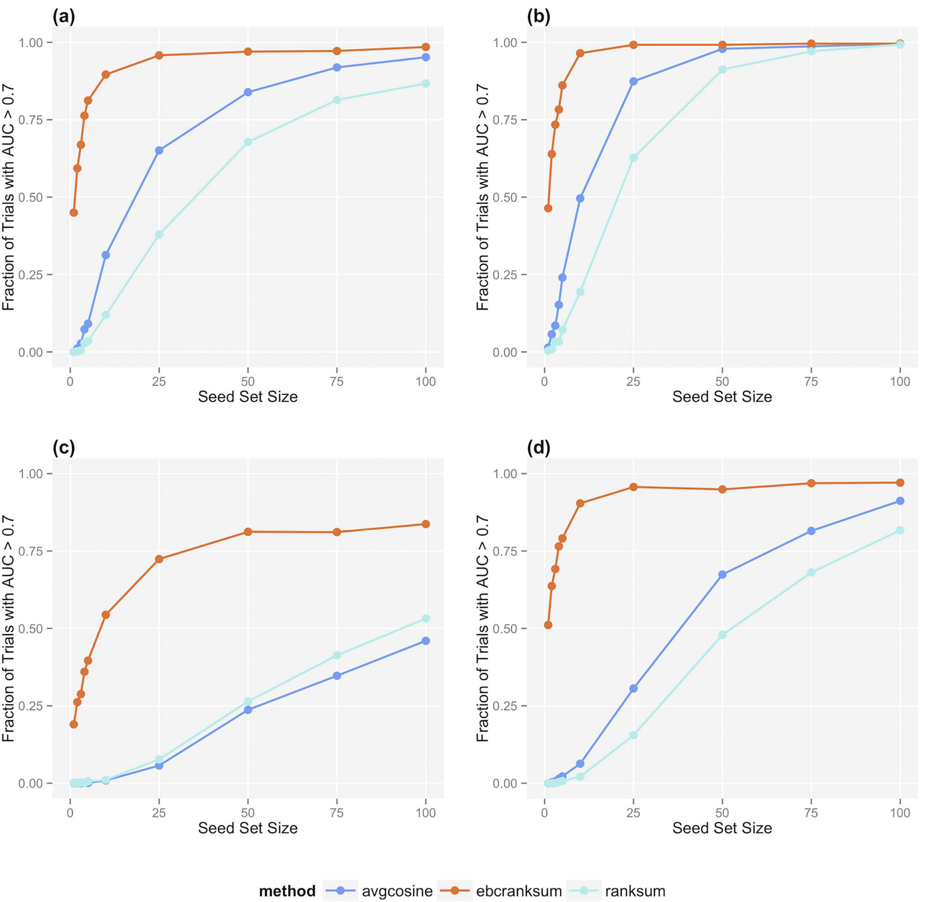
Classifier performance
(a) PGx associations
(dense matrix)
(b) drug-target associations
(dense matrix)
(c) PGx associations
(sparse matrix)
(d) drug-target associations
(sparse matrix).

Slide 10
Inferring connections among related descriptions based on patterns in the text
The backbone of EBC is a bi-clustering algorithm called Information-Theoretic Co-Clustering (ITCC).
Fig 3 shows the result of one ITCC run on a small sample dataset consisting of dependency paths that connect different drugs to the gene CYP3A4
(a liver cytochrome involved in the pharmacokinetic pathways of many drugs) at least five times in Medline.
This dataset contains 62 drug-gene pairs (where the gene is always CYP3A4) and 14 unique dependency paths.
We used ITCC to bi-cluster this matrix into four row clusters and six column clusters.

Slide 11
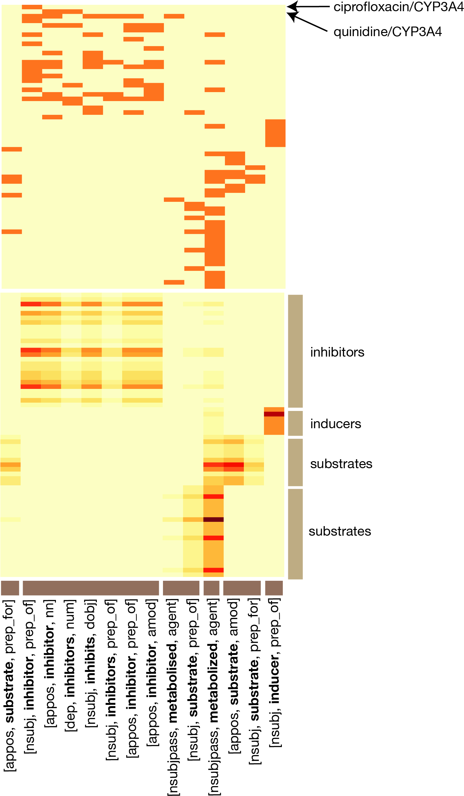
Example of ITCC output for a small matrix consisting of drug-CYP3A4 pairs and their associated dependency paths.
An orange square represents an observed path (column) between a given drug-gene pair (row).
The top heatmap shows the original data after the clustering was performed.
The bottom heatmap shows the approximate distribution arising from a single ITCC run.

Slide 12
Inferring connections among related descriptions based on patterns in the text
Fig 3 shows that the dependency paths naturally fragment into clusters reflecting known biomedical properties.
Cluster 2 : referred as inhibition.
Cluster 6 : reffered as induction
Else : Included paths describing situations where the drug is a substrate of CYP3A4, or is metabolized by it.
Table 3 shows some dependency paths from this dataset that frequently cluster together over 2000 separate runs of ITCC.

Slide 13
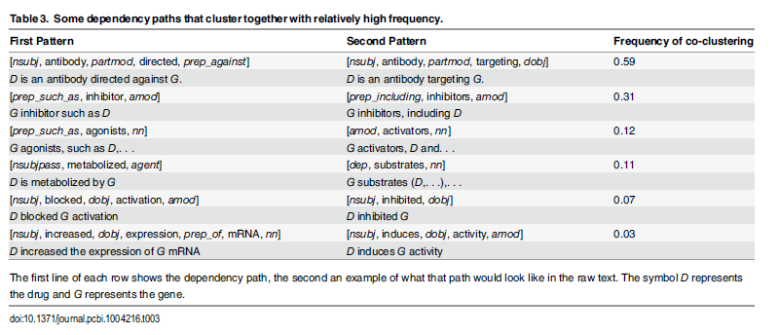

Slide 14
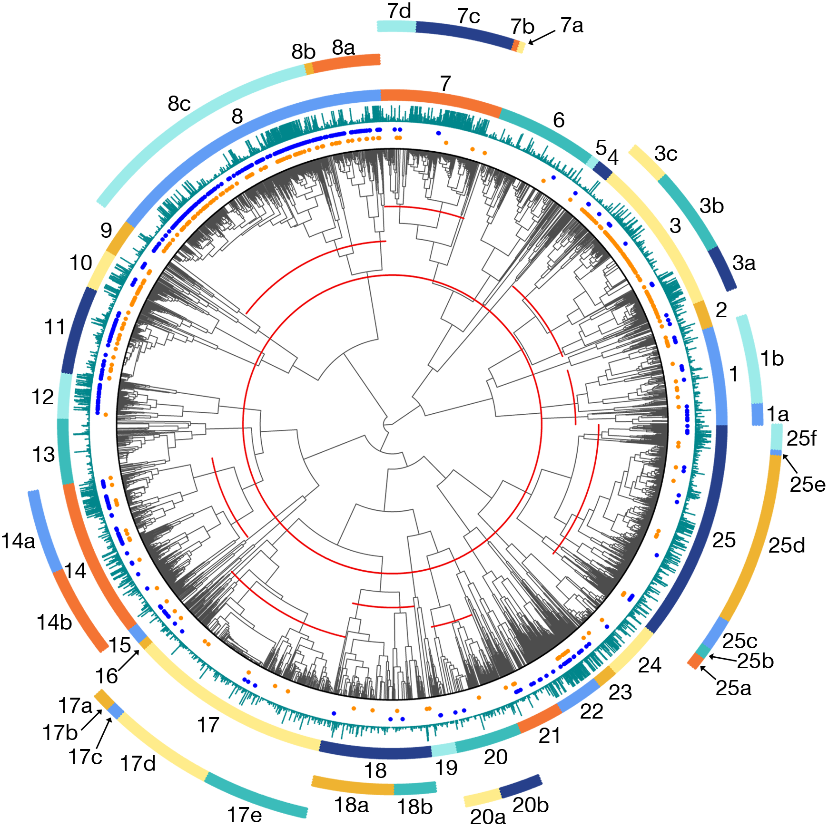
EBC provides a measure of relationship similarity between every drug-gene pair and every other pair
(the frequency with which each pair of rows in the data matrix cluster together).
3514 drug-gene pairs that co-occur in Medline sentences at least 5 times
the colored clusters shown around the edges.
Drug-gene pairs that are known drug-target relationships from DrugBank are denoted by blue dots, PharmGKB are denoted by orange dots.
The heights of the turquoise bars are proportional to how often the corresponding drug-gene pairs co-occur in Medline sentences.

Slide 15
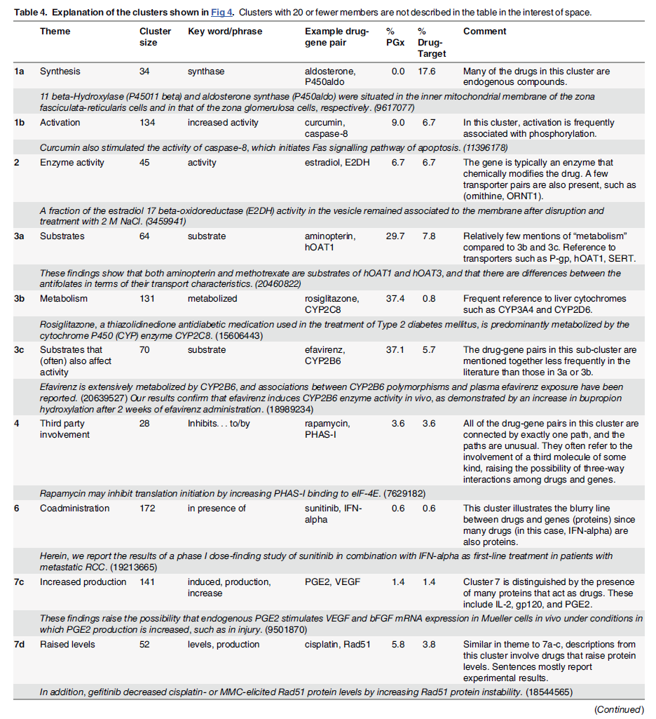
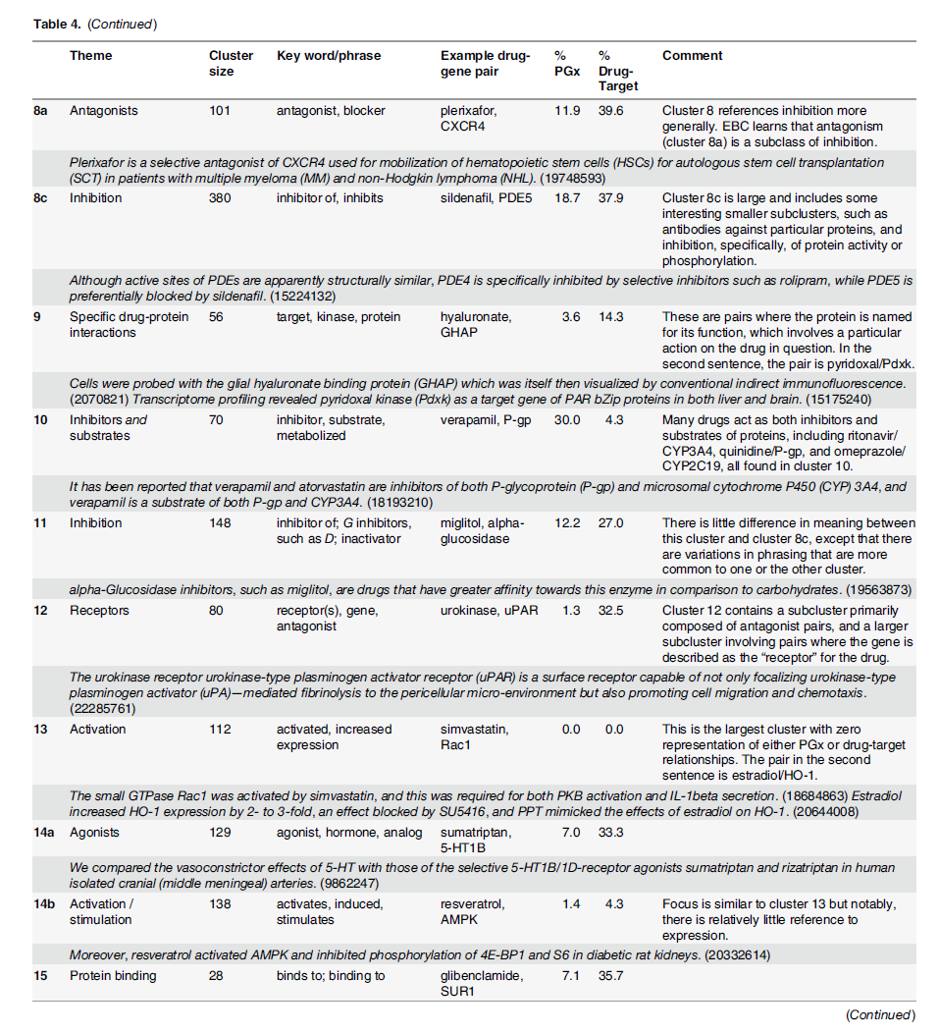

Slide 16
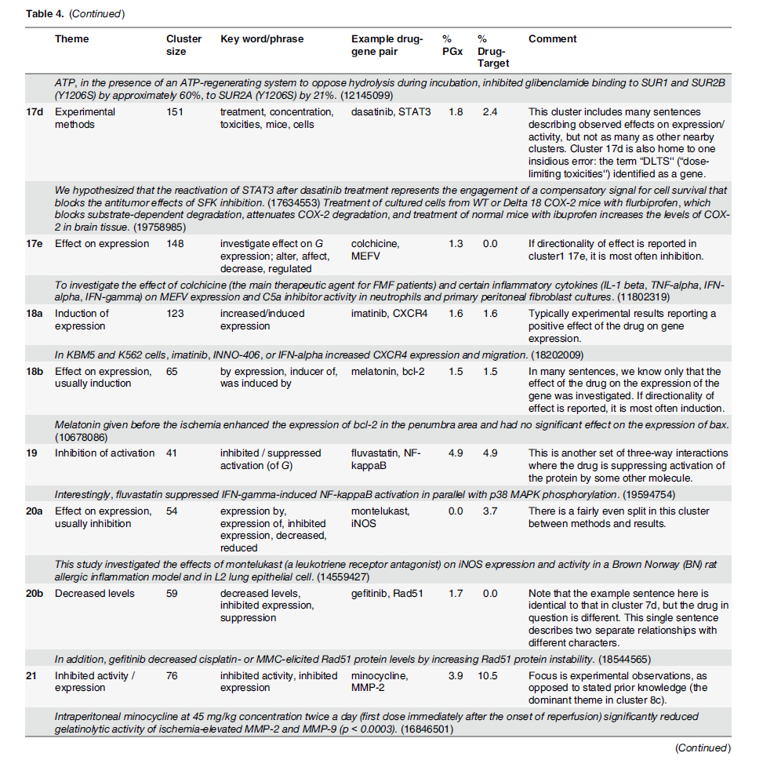
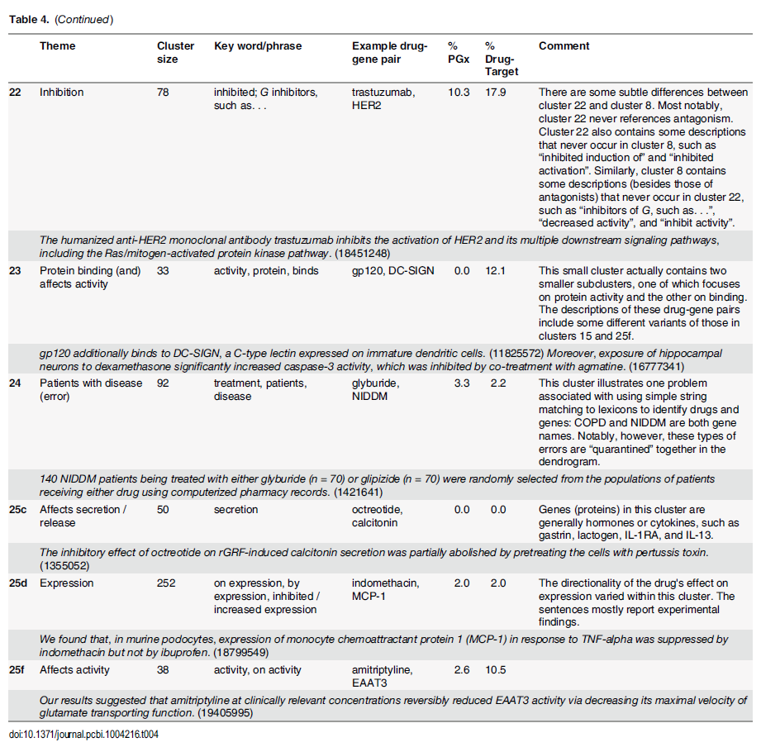

Slide 17
Mapping the semantic landscape of drug-gene interactions
Cluster 8, the largest cluster, contains drug-gene pairs whose descriptions mainly refer to inhibition.
This cluster is highly enriched for both PGx and drug-target relationships.
a subcluster (8a) of antagonists and their protein targets splits off from the main cluster.
Cluster 10, which is a close relative of cluster 8 in the dendrogram,
contains drug-gene pairs where the drug is both an inhibitor and a substrate of the protein
such as verapamil/P-glycoprotein.
Cluster 3 contains three sub-clusters with slightly different properties.
Cluster 3a : mainly substrate relationships where the concept of “metabolism'' is not mentioned.
Transport relationships like aminopterin/hOAT1.
Cluster 3b : most of the metabolic relationships, many of which involve liver cytochromes like CYP3A4 and CYP2D6.
Cluster 3c : substrate relationships where the drug is often also described as having an effect on the activity of the protein.
Other clusters enriched for drug-target relationships include cluster 12
where the protein is described as the receptor for the drug, cluster 14a, where the drug is described as an agonist of the protein, and cluster 15, which refers to protein binding.
Notably, cluster 14a (agonists) is part of a larger cluster, cluster 14, that encompasses activation and stimulation relationships.
Interestingly, cluster 14b, the part of cluster 14 that refers to activation more broadly and does not specifically refer to agonism, is not enriched for drug-target relationships.

Slide 18
Mapping the semantic landscape of drug-gene interactions
Clusters 1–16 : in general, each displayed a consistent theme.
Clusters 17–25 : descriptions of experimental methods or results about drug effects on gene expression or protein activity.
Here, the dendrogram reveals a distinction between past and present knowledge.
Drug-gene pairs that are already well-studied are often reported in a static context
“D is an inhibitor of G”, or “D is a G agonist”
Other pairs are reported primarily in an experimental context
“we investigated the effect of D on G expression”, “G was activated by D”, or “exposure to D significantly increased G activity”.
Mostly static descriptions : cluster 8. Mostly experimental descriptions : cluster 21
Interestingly, drug-gene pairs from cluster 21 appear together in the literature significantly fewer times than drug-gene pairs from cluster 8
(median 9 times for cluster 21 vs. 16 times for cluster 8; maximum 66 times for cluster 21 vs. 2722 times for cluster 8; p < 0.0001, Mann-Whitney test)
->Corroborating our assertion that the drug-gene pairs from cluster 21 represent more tentative experimental findings as opposed to well-established static knowledge.
Finally, the dendrogram reveals that PGx and drug-target relationships do not constitute distinct classes of relationships, but are chimeras.
PGx relationships are composed of relatively distinct subgroups corresponding to
(a) situations where the drug inhibits the gene/protein (and therefore, mutations in the gene could be expected to impact response to the drug)
(b) situations where the protein is involved in the metabolism or transport of the drug.
Drug-target relationships overlap with (a), such as receptor binding and agonism.

Slide 19
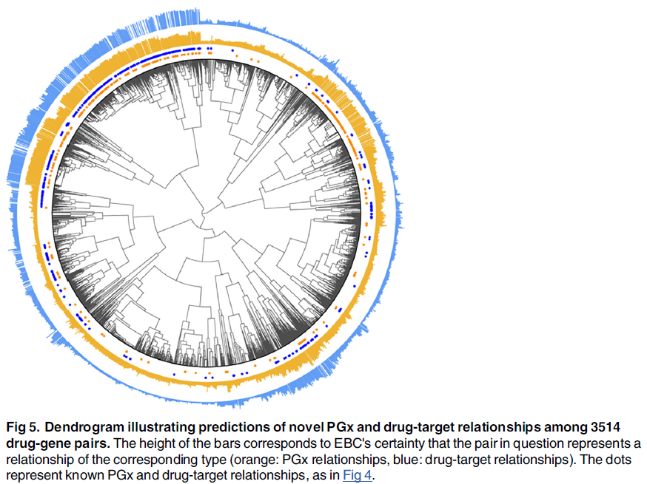
Discovering novel relationships for PharmGKB and DrugBank

Slide 20
Discovering novel relationships for PharmGKB and DrugBank
EBC reliably detects new drug-gene pairs reflecting relationships of interest to PharmGKB and DrugBank, so we attempted to discover new examples from our corpus.
We built seed sets containing all known relationships from PharmGKB and DrugBank and incorporated these into EBC to rank the remaining drug-gene pairs
according to EBC’s certainty that they represented PGx or drug-target relationships.
There was 13.6% overlap between the two seed sets, with 84 drug-gene pairs in both, 206 in PharmGKB only, and 326 in DrugBank only, and 2898 pairs that were unknown to both.
Known PGx or drug-target pairs are excluded from the bar graphs, but are denoted beneath the bars with orange or blue dots.
high prediction certainty for drug-target and PGx relationships among the inhibitors in cluster 8,
high certainty for PGx relationships among the metabolic/substrate relationships in cluster 3.
We also observe an interesting area of high enrichment for both types of relationships among clusters 21–23, where inhibition is mostly reported in an experimental context, but the density of known PGx and drug-target relationships is quite low.

Slide 21
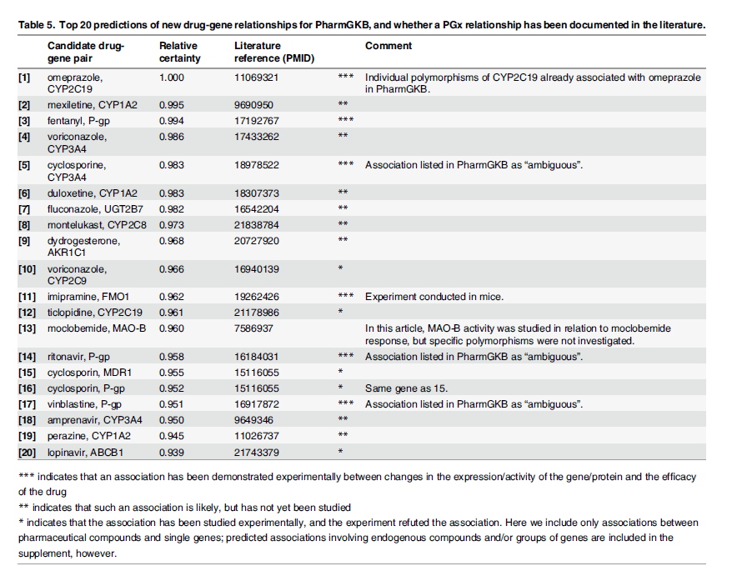
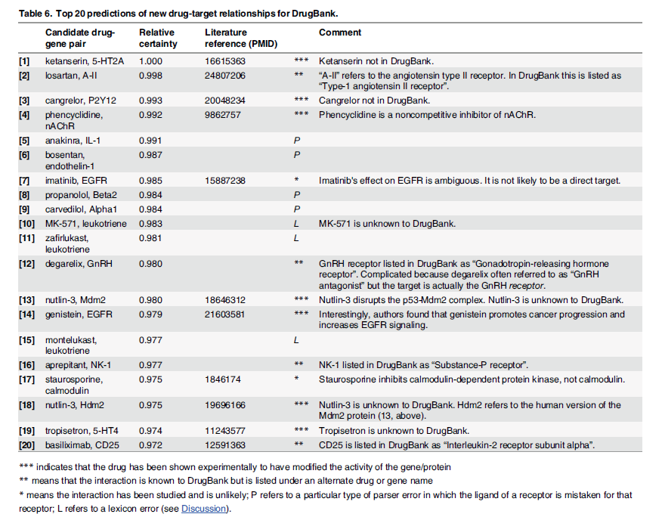

Slide 22
Discovering novel relationships for PharmGKB and DrugBank
Table 5 shows the top 20 predictions of new PGx candidate pairs for PharmGKB, and Table 6 shows the top 20 candidate drug-target pairs for DrugBank.
The top 20 prediction for PharmGKB (PGx)
Five are already known to PharmGKB and have been demonstrated
but were coded in the PharmGKB relationships file in such a way that they were not included in the seed set.
One is brand new:
polymorphisms in ABCB1 (P-glycoprotein) do impact clinical response to fentanyl
but this relationship is currently unknown to PharmGKB.
An additional eight pairs represent likely PGx relationships, such as known inhibitory or metabolic relationships, but no experiments have yet been conducted that might relate polymorphisms in the gene to drug response.
And finally, in five cases, the potential for a PGx association was considered likely enough that it was investigated experimentally, but no significant clinical association between genotype and drug response was found.
The top 20 predictions for DrugBank
four are already known but were listed in DrugBank under alternate gene names.
An additional seven are new, proven drug-target relationships.
Of these, five involve drugs that are themselves unknown to DrugBank (there are no entries for ketanserin, cangrelor, nutlin-3, or tropisetron in DrugBank).
There are also several interesting, yet erroneous findings arising from parser and lexicon errors in which a molecule, such as IL-1, is mistaken for its receptor, and that receptor is the true target of the drug.

Slide 23
Disscussion : Relationship extraction in the biomedical domain
Although a great deal of research effort has been directed at the problem of relationship extraction in pharmacogenomics, and in the biomedical domain in general, high quality biomedical knowledge bases like OMIM, DrugBank and PharmGKB still rely almost entirely on human curators, who comb the literature manually in search of new relationships.
Why is biomedical relationship extraction so challenging?
-> Sentence-level descriptions are highly erratic.
Faced with a bewildering array of possibilities for how similar relationships can be described, sentence-level relationship extraction algorithms often rely on manually-constructed rules or ontologies that map diverse surface forms onto common semantics.
These systems require a non-trivial amount of human maintenance and must be rebuilt for each new domain.
Machine learning algorithms for sentence-level relationship extraction avoid rules
but face another serious problem: the need for annotated training sentences.
Recently, researchers have begun to produce annotated training sets for the biomedical domain but manual annotation is too expensive both in time and human effort.
As a result, little to no annotated training data exist for many classes of biomedically interesting relationships.
These are important problems for NLP, but they only exist because we think of biomedical relationships at the level of individual sentences.
From a biomedical research standpoint, there is no need to do so—we are most interested in the true relationship between a drug and a gene,not in the meaning of any particular sentence.
As a result, we have taken a corpus-level approach where all of the information about a drug-gene pair from all of its available sentence level descriptions is combined.
Latent connections among different-looking descriptions are then discovered in an unsupervised fashion from structure inherent in the raw text, requiring no human effort and boosting our ability to extract relationships of interest.

Slide 24
Disscussion : Support for corpus-level inference
We contend that biomedical relationships should be considered properties of biomedical entities like drug-gene pairs, not individual sentences.
A description like “D decreased G levels” does not constitute an inhibitory relationship;
it is simply an experimental finding that increases the likelihood of such a relationship.
This allows the same sentence to provide evidence for or against multiple types of relationship, the exact definitions of which are application dependent.
It also allows drug-gene pairs to exhibit multiple relationship types at once.
We see evidence for such an approach when we contrast EBC’s performance at extracting PGx relationships with its performance extracting drug-target relationships.
EBC was uniformly worse at extracting PGx relationships, even though these two sets of experiments used the same data matrices.
We see why in Fig 4: it turns out that what we originally considered to be well-defined relationship classes (PGx and drug-target relationships) are actually composites of several finer-grained sub-classes.
A high percentage of PGx relationships reside in cluster 3, the metabolism/substrate cluster, which inhabits a region of the dendrogram far from the inhibition clusters.
In cases where the seed set consists mostly of metabolic relationships and the test set mostly of inhibition relationships, we would not expect EBC to perform well, even though both groups are still technically PGx relationships.
We initially believed that PGx relationships would be expressed in sentences relating specific polymorphisms to changes in drug efficacy, such as, “The CYP3A4 C3435T polymorphism influences rifampicin exposure in human hepatocytes”.
In reality, however, relatively few such sentences exist.
Most evidence for PGx relationships comes instead from descriptions of other types of relationships, such as inhibition and metabolism.
So we see that although a PGx relationship can be considered a property of a drug-gene pair, it is not generally a property of any particular sentence describing that pair.

Slide 25
Disscussion : Distributional semantics for relationship extraction
EBC is part of a subfield of NLP called distributional semantics, in which patterns in large, unlabeled text corpora are used to create feature representations of words, phrases, or other entities (in our case, drug-gene pairs) based on how they are used in context.
The similarity of these representations then serves as a proxy for semantic relatedness [12].
Distributional semantics algorithms’ theme of discovering semantic relatedness by looking at large-scale usage patterns inspired our corpus-level approach to drug-gene relationship extraction.
For example, in EBC, these representations are the co-clustering frequencies of each drug-gene pair with every other pair, and the contextual features are the dependency paths.
EBC builds on a long history of distributional semantics work in the NLP literature, much of which focuses on assessing the semantic similarity of individual words [12, 13, 32], and some of which has tackled relationship extraction outside the biomedical domain [33–36].
EBC is most similar in spirit to matrix factorization techniques like Latent Semantic Analysis (LSA) [13];
ITCC forms a low-rank approximation of the original drug-gene-pair-by-dependency-path matrix, and EBC stacks thousands of slightly different ITCC-based approximations on top of each other to make its similarity assessments.
LSA uses the singular value decomposition (SVD) [37] instead of ITCC to accomplish a similar goal, and has been applied in at least one case to corpus-level relationship extraction (a technique called Latent Relational Analysis, or LRA) [36].

Slide 26
Disscussion : Study limitations: Dependency paths, lexicons and abstracts
In our analysis of drug-gene relationships, we made several choices about (a) how to identify drugs and genes in text, (b) the type of text to use as our corpus, and (c) what constitutes a “feature” (a single column in the data matrix).
In all cases, we made the simplest choices possible, both to enable others to reproduce our results, and to distinguish EBC’s own limitations from errors/omissions in the preprocessing steps and text itself.
We identify drugs and genes in the text based on simple string matching to single-word drug and gene names from PharmGKB [5].
Named entity recognition (NER) is its own area of NLP, and identifying biomedical entity names in text is itself a nontrivial proposition.
We can see one obvious disadvantage of this approach in cluster 24 of Fig 4 and Table 4, which includes “gene names” like COPD (a.k.a. chronic obstructive pulmonary disease) and NIDDM (noninsulin-dependent diabetes mellitus).
Table 6 also reflects a lexicon error where the term “leukotriene” is listed as a synonym for the leukotriene B4 receptor.
Some such errors might be avoided if we used a more elaborate NER system [47, 48], though such systems themselves are not perfect and can introduce new sources of error.
Our stipulation that the entity names be single words also led to errors in cases (see Table 6) where a molecule, such as IL-1, is mistaken for its receptor, the “IL-1 receptor”, because “IL-1 receptor” is a multi-word phrase not allowed in the lexicon, while “IL-1” is allowed.
We also made no attempt to normalize gene names, so in our results, ABCB1, MDR-1, and P-gp are all different. Again, this was done to avoid introducing normalization errors, and because genes and their corresponding proteins are often described in different contexts.
To construct dependency paths from raw Medline sentences, we used the Stanford Parser [49], a free and open-source statistical parser. The Stanford Parser was trained using labeled text from newswire corpora, so it sometimes fares poorly on biomedical text.
For example, the parser often mistakes gene names for adjectives (“CYP3A4” in the phrase “CYP3A4 polymorphism” is frequently labeled as an adjective). We used the out-of-box implementation of the Stanford Parser and did not perform any manual review or correction of parses to improve its performance (again in the interest of simplicity).
Because EBC operates at the level of drug-gene pairs and not individual sentences, its performance is generally robust to parsing errors as long as the parser makes the same errors consistently.
There are some errors that do lead to incorrect conclusions, however.
For example, we observe some situations where dependency paths bypass important details about relationships, such as a sentence where a drug is described as “transcriptionally up-regulating G expression” and the dependency path only captures the effect on expression, not its directionality.
These are usually generalizations rather than errors, but they do result in some loss of information from the sentence.
Finally, our corpus consisted of all abstracts from the 2013 edition of Medline.
Including information from the full text of the research articles could help discover relationships not mentioned in the abstracts, but many journals do not provide access to the full text, and we did not wish to bias our results in favor of relationships reported in a subset of journals.
Our approach would remain the same regardless of the corpus.

Slide 27
Methods : EBC ( Ensemble Biclustering for Classification )
Preprocessing (drug-gene relationship extraction task):
1. Identify all drug-gene pairs co-occurring in sentences within a corpus of text. (In our experiments, these were drug-gene pairs co-occurring in Medline sentences.)
Call the number of drug-gene pairs n.
2. Extract all dependency paths connecting these drug-gene pairs in the corpus. Call the total number of observed paths m.
3. Arrange the data in an n x m matrix where the rows represent drug-gene pairs and the columns dependency paths. A cell with coordinates (i, j) in this matrix contains “1” if druggene pair i has been connected by path j somewhere in the corpus, and “0” otherwise.
EBC algorithm:
4. (Unsupervised step.) Use Information-Theoretic Co-Clustering (ITCC; [16], details below) to bicluster the n x m matrix N times, recording the number of runs in which each row appears in a row cluster with each other row.
The result is an n x n array, C, of co-occurrence values.
Note that no information about the seed set is incorporated at this stage, so the unsupervised step need be run only once per data matrix.
5. (Supervised step.) Identify a seed set, S, of rows that share some property of interest. (In our experiments, these were drug-gene pairs with known PGx or drug-target relationships.)
Rank the entity pairs in a test set, T, based on a scoring function related to how often they co-cluster with members of S (details below). Repeat this step as desired with different seed sets.

Slide 28
Methods : Extraction of dependency paths from Medline abstracts
We used the Stanford Parser [49] to generate dependency graphs for all sentences in Medline 2013 between 4 and 50 words in length (roughly 95% of all sentences in Medline).
The input to the parser is a raw Medline sentence, and the output is a dependency graph.
A dependency graph (see Fig 1) is one way to represent the grammatical architecture of a sentence; the nodes are words, and the edges are grammatical dependencies (grammatical relationships between pairs of words, described in detail in [15]).
A dependency path is a path through a dependency graph that connects two entities of interest.
Considering a dependency path, instead of an entire sentence, can help “prune out” irrelevant terms and phrases and focus our attention on the part of the sentence directly relevant to the relationship between the two entities.
We extracted all dependency paths linking drugs to genes.
It was possible for a single sentence to generate more than one dependency path if multiple drug or gene names were present in the sentence.
We oriented our paths so that they always started at the drug and ended at the gene, and we eliminated edge directions. (We never observed a single situation where we accidentally collapsed paths with different meanings in doing so, since most pairs of words can only be connected by a particular dependency type, like
amod or nn, in one direction.)
We eliminated paths containing dependencies of type conj [15],because these were usually errors arising from inadequacies in how the dependency parser represents lists.
Note that because the dependency graphs are trees, there is one unique dependency path for each drug-gene pair in a sentence.

Slide 29
Methods : Scoring of test set pairs
Once EBC’s unsupervised step is performed and appropriate seed (S) and test (T) sets identified,
test set items can be ranked as follows:
1. EBC’s scoring function. For each test set member, Ti, rank all n rows of the data matrix
based on how often they co-cluster with Ti. This produces a ranking Ri of length n in which
pairs that frequently co-cluster with Ti are assigned high ranks and those that seldom cocluster
get low ranks. The score for Ti is the rank sum of the members of the seed set, S,
within this list, or:
Using ranks instead of absolute co-clustering frequencies produces a score that does not
depend on how often, on average, a given drug-gene pair co-clusters with other pairs, since this baseline “promiscuity” changes from pair to pair. For some applications, those differences might not matter (or they might be informative) but we normalized to ranks so promiscuous pairs (which are often well-known or frequently mentioned pairs) would not consistently receive higher scores than less promiscuous pairs.
EBC’s scoring function will assign a high score to a test set member as long as the seed set rows tend to cluster with it more frequently than other rows do. Ties are broken randomly.

Slide 30
Methods : Scoring of test set pairs
We compared EBC’s performance to two other ranking methods that did not take the semantic similarity of different dependency paths into account:
2. AvgCosine.
Let vTi be the row vector in the data matrix associated with test set member i.
This vector contains m elements: one for each dependency path. Let vSj be the row vector
associated with seed set member j. Here we score each test pair Ti based on the average
cosine similarity of vTi with all of the row vectors from the seed set, or:
3. RankSum. In keeping with the spirit of EBC’s scoring function, for each Ti we rank all n rows of the data matrix based on cosine similarity to vTi .
This produces a ranking Ri of length n in which rows with high cosine similarity to vTi are assigned high ranks and those with low cosine similarity to vTi get low ranks.
The score for Ti is the rank sum of the member of S within this list, and looks identical to that for EBC;
the only difference is that the rankings Ri are produced using cosine similarity and not EBC.

Slide 31
Methods : Evaluating rankings of PGx and drug-target relationships
For both the PGx and drug-target tasks, and for seed set sizes |S| = 1, 2, 3, 4, 5, 10, 25, 50, and 100, we generated 1000 random seed sets and 1000 corresponding test sets, ensuring that the seed sets and test sets did not overlap.
The test sets were all composed of 100 drug-gene pairs, 50 of which had known PGx or drug-target relationships and 50 of which did not.
All three ranking methods were used to rank the members of each test set, using its associated seed set for scoring.
We also explored the impact of data sparsity by performing these evaluations on two separate datasets.
In the “dense” dataset, we included only drug-gene pairs and dependency paths that occurred at least five times in Medline.
In the “sparse” dataset, we included dependency paths occurring at least twice, and any drug-gene pairs they connected (even if they only cooccurred in a single sentence).
More information about the two datasets can be found in Table 2, and the data matrices themselves can be found in S2 Data.
We evaluated the quality of each ranking by calculating the area under the receiver operating characteristic curve (AUC) [52], a measure of how likely it is that a positive element of the test set will be ranked higher than a negative element.
We elected to use AUC instead of precision or recall because we wanted a threshold-independent measure of the overall quality of the ranking.
We used R’s ROCR package to calculate the AUCs.
From a practical standpoint, we were concerned mainly with the following scenario:
Given that I have a seed set about whose quality I know nothing, what is the chance I can accurately prioritize the knowledge I am looking for within my [unlabeled] corpus?
Our evaluation metric was, therefore, the fraction of the 1000 seed sets that ranked their corresponding test sets with AUC > 0.7.

Slide 32
Methods : Comparing EBC to Latent Semantic Analysis (LSA)
To investigate how similar EBC’s performance was to a more established method designed to solve a similar problem, we used the singular value decomposition (SVD) to decompose our two data matrices, creating “compressed” feature vectors of reduced dimensionality for each drug-gene pair and incorporating these, rather than the raw row vectors, into the two non-EBC ranking methods described above.
This approach is identical to the famous text mining technique Latent Semantic Analysis (LSA; [13]) which was originally applied to overcome issues of data sparsity in document retrieval.
The results of these experiments are described further in S2 Text.

Slide 33
Methods : Building a dendrogram of drug-gene pairs based on EBC’s similarity assessments
EBC provides a natural measure of similarity for each drug-gene pair and every other pair:
the number of times the rows corresponding to those two pairs clustered together over the N biclustering runs. However, as we have seen, these raw values are not fair measures of distance for all pairs, since some drug-gene pairs tend to cluster frequently with many other pairs, and others cluster less frequently.
EBC’s rank-based scoring function accounts for this by normalizing to ranks:
each drug-gene pair ranks all other pairs by co-clustering frequency,
and these ranks are used in place of the raw co-clustering values in the scoring function.
To implement EBC's scoring function in an unsupervised manner to construct our dendrogram, we started with our n x n matrix of co-occurrence values, C, in which Cij was the number of runs (out of N total) in which drug-gene pair i co-clustered with drug-gene pair j.
We then converted C into a correlation matrix, ρ, also n x n, where ρij contained the Spearman correlation of Ci and Cj, the ith and jth rows of C (note that C is symmetric, so we could just as easily have used columns).
These correlations are, as in EBC's scoring function, measures of how similarly drug-gene pair i and pair j rank all other pairs in the matrix, and are not biased in favor of promiscuous pairs.
We then used 1 − ρ as the distance measure for hierarchical clustering using minimax linkage [53] to produce the dendrogram shown in Fig 4.
Using a different linkage function or distance metric, obviously, would produce a different-looking dendrogram.
We used several R packages to produce the dendrogram figures, including ape (a library for making phylogenetic trees), and protoclust (a library for hierarchical clustering using minimax
linkage).
To achieve the radially-spaced tip markers, we used a separate package [54].

